Slide 1
PC Maintenance: Preparing for A+ Certification
Chapter 19: Imaging and Sound Devices

Slide 2
Chapter 19 Objectives
Understand scanner technology
Install and use a scanner in Windows
Transfer pictures from digital camera to PC
Troubleshoot scanners and cameras
Understand sound technology
Select and install a sound card
Troubleshoot sound problems

Slide 3
Scanner Technology
Charge-coupled device (CCD)
  Captures light bouncing off the image and converts it to a numeric value
Contact Image Sensor (CIS)
  Inexpensive LED alternative to CCD

Slide 4
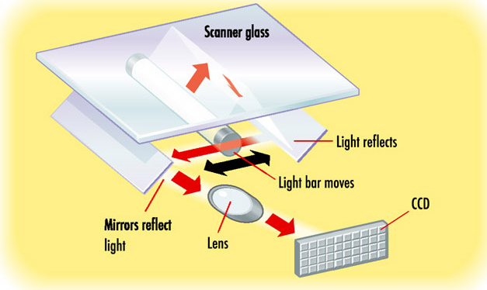
How a CCD Works

Slide 5
Scanner Vocabulary
X-direction sampling rate
  Number of cells in the CCD per inch of image
Y-direction sampling rate
  Number of vertical positions per inch captured as the sensor moves down the page
Interpolation
  Inserting extra pixels between two captured ones by averaging their values

Slide 6
Scanner Bit Depth
Number of bits required to describe a pixel
The higher the bit depth the more colors to choose from when attempting to describe a pixel
All scanners today support at least 24-bit scanning (“True Color”)

Slide 7
Bit Depths Above 24-Bit
Extra bits in bit depth above 24 are used for error correction
  Brightness
  Color correction
  Best 24 bits are kept, the rest are thrown out before data is sent to PC
  This is better than the PC attempting to do the correction itself

Slide 8
Scanner Interface
USB
  Most common today
SCSI
  Typical of very high-end scanners
Legacy parallel
  Becoming obsolete

Slide 9
Other Measurements of Scanner Performance
Scanning speed
  To compare, must be based on a consistent page size between models
Dynamic range
  Ability to distinguish light and dark
  Scale runs from 0 to 4
  Higher number is better (for example, 3.2)

Slide 10
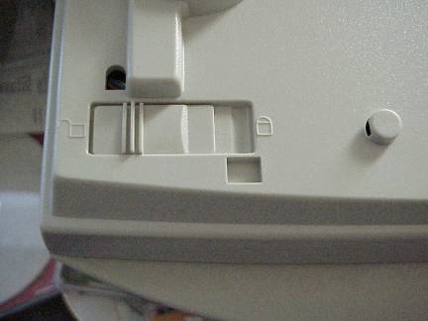
Installing a Scanner
Remove any tape seals on new unit
Locate locking mechanism and unlock it

Slide 11
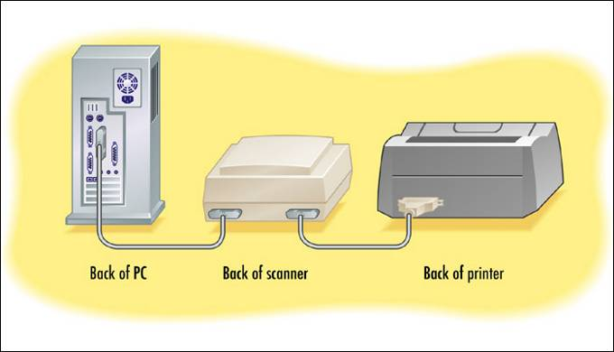
Installing a Scanner
Legacy parallel scanner can share port with printer using pass-through

Slide 12
Windows Versions and Scanners
Windows 9x and 2000:
  No native support
  Install the scanner’s own software
  TWAIN interface

Slide 13
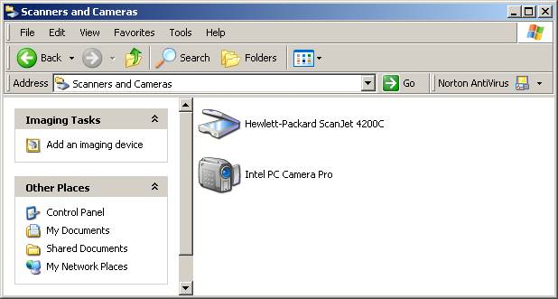
Windows Versions and Scanners
Windows Me and XP:
  Native support for some scanners
  Install scanner’s software only if needed

Slide 14
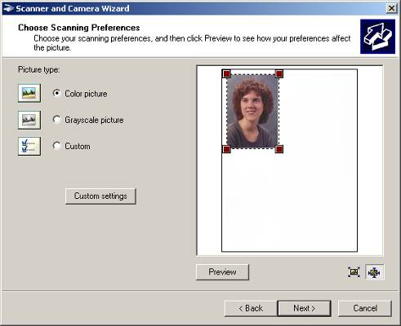
Scanner and Camera Wizard
Windows Me and XP
Consistent interface for all brands and models of scanners

Slide 15
Troubleshooting Scanner Problems
Is scanner receiving power?
Are cables snug?
Is scanner unlocked?
Is the interface fully functional (i.e. not disabled)?
Is scanner sharing a parallel port? If so try disconnecting printer temporarily

Slide 16
Digital Cameras
Similar technology to scanners
Also use CCDs
Store images on memory cards rather than sending them immediately to the computer

Slide 17
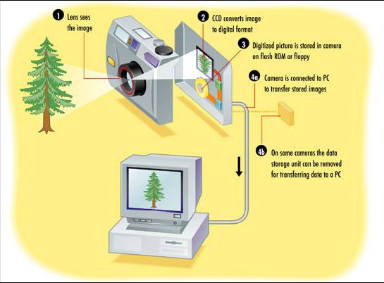
How a Digital Camera Works

Slide 18
Digital Camera Features
Camera size
Maximum resolution (megapixels)
Zoom
Storage medium
Interface to PC
Manual adjustments
Delay between pictures
Flash

Slide 19
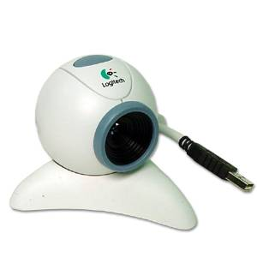
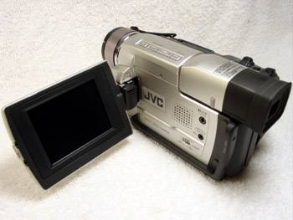
Digital Video Cameras
Portable video cameras
Webcams

Slide 20
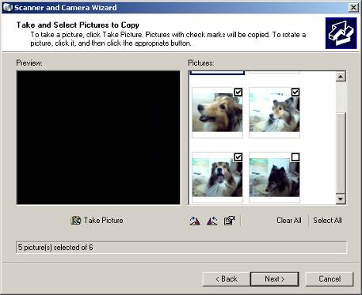
Digital Camera Support in Windows
Windows Me and XP only
Scanner and Camera Wizard
Also can open as a regular file management window

Slide 21
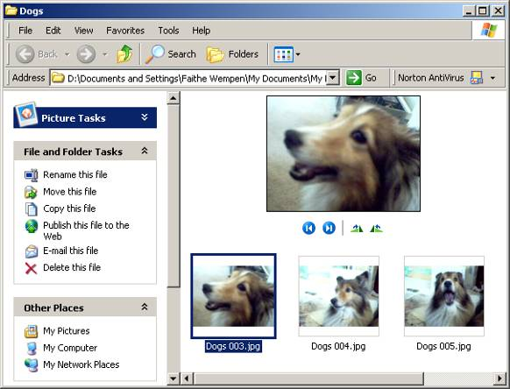
Working with Images in Windows
Windows XP: Filmstrip View

Slide 22
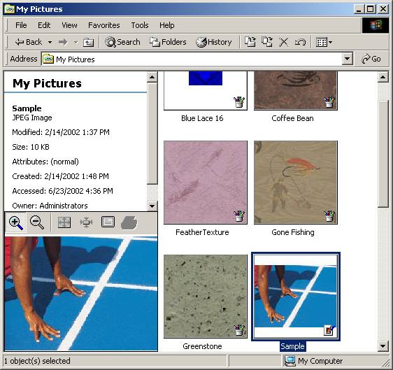
Working with Images in Windows
Windows Me and 2000: Image Preview
Set up with View > Customize This Folder

Slide 23
Understanding the Sound Subsystem
Motherboard
Sound card (if separate from motherboard)
Speakers
Microphone
MIDI instruments
CD drives that play audio CDs
Other I/O devices

Slide 24
Digital Audio and MIDI
Digital Audio
  Originally had an analog source
  Digitized from the original
MIDI
  Created with a digital instrument
  No analog origin
  Digital original simply recorded, not converted

Slide 25
MIDI
Stands for Multi-Instrument Digital Interface
Most common instrument is a keyboard
Most sound cards have wavetable synthesis
  Recorded clips of various instruments playing various notes
  MIDI recording is played back using these clips when possible for a more natural sound

Slide 26
Selecting a Sound Card
PCI interface
Input and output ports
MIDI features (if desired)
Digital audio features (if desired)

Slide 27
Features Important for MIDI
New instrument capability
Polyphony
ROM size
RAM size
Synthesizer effects
MIDI channels
Effects engine
Recording depth
Maximum recording rate
Playback depth
Maximum playback rate
Signal-to-noise ratio

Slide 28
Features Important for Digital Audio
Built-in amplifier
Sound Blaster compatibility
Microsoft DirectSound Support
EAX support
Dolby Digital 5.1 decoding
Separate speaker and woofer adjustments

Slide 29
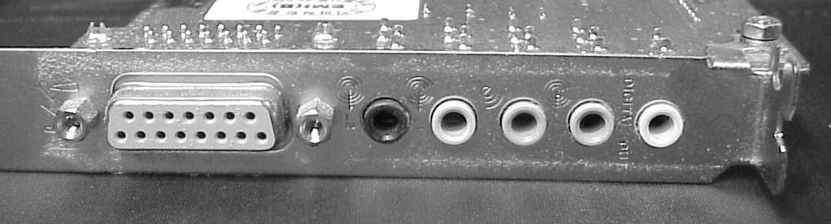
External Ports
MIDI
Line Out
Line In
Microphone
Speaker
Digital Out
Headphones
Optical Out
Optical In

Slide 30
Typical Color Coding
Port | Color
Line Out | Green
Speaker Out | Black
Microphone | Red
Line In | Blue
Digital Out | Yellow

Slide 31
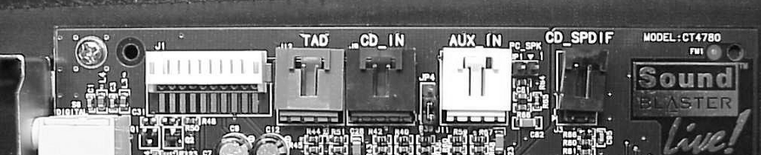
Internal Ports
Telephone Answering Device
CD In
Sony/Philips Digital Interface (S/PDIF)
TV Tuner
Microphone Connector
Auxiliary In

Slide 32
3D Sound
Similar to Surround Sound in a movie theatre
Mostly for games
Requires programmers who wrote the application to have included commands that use an API that the sound card supports
Works best when you have more than two speakers

Slide 33
3D Sound APIs
Not all sound cards support all APIs
Some popular APIs include
  Microsoft DirectSound3D
  A3D
  EAX
  Sensaura

Slide 34
Installing a Sound Card
Like any other expansion board
If sound is built into motherboard, disable in BIOS Setup or in Windows
Attach audio cable from CD drive to sound card to play CDs directly through sound card

Slide 35
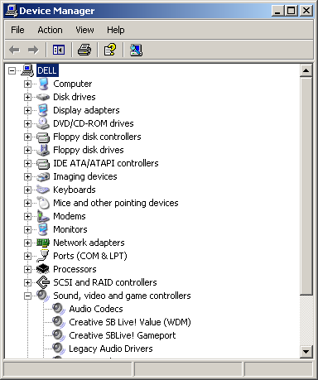
Setting Up the Sound Card in Windows
Run Setup utility for sound card
Check it in Device Manager
Multiple sound devices might appear there even though it is a single physical card

Slide 36
Troubleshooting Sound Problems
Windows does not see the sound card
  Run the Setup software for the card
Card is recognized but no sound is heard
  Speakers not connected
  Speakers not powered on
  Volume not turned up
  Volume muted in Windows

Slide 37
Troubleshooting Sound Problems
Audio CDs will not play
  Audio cable not attached between CD drive and sound card
  Digital audio playback not enabled in CD drive’s properties in Windows
No system sounds
  Sound scheme not chosen in Sounds properties in Control Panel

Slide 38
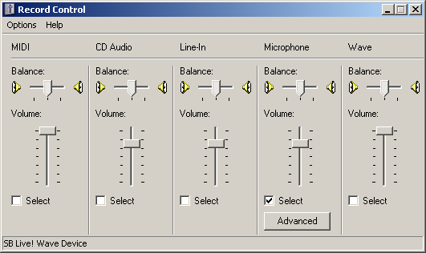
Microphone Problems
No sound when recording
  Recording control is not selected in Windows
  Microphone not plugged into correct jack

Slide 39
Selecting Speakers
Amplification
  Root Mean Squared (RMS)
  RMS Maximum
  PMPO
Shielding
Number of Speakers
Frequency Range
Analog vs. Digital Speakers

Slide 40
Installing Speakers
Two speakers:
  One speaker connects to PC
  Second speaker connects to other speaker
More than two speakers:
  All speakers connect to subwoofer
  Woofer connects to PC

Slide 41
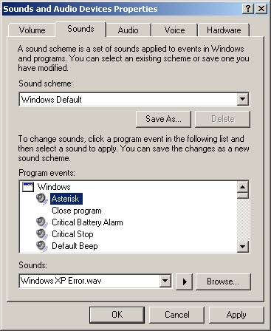
Sound Support in Windows
System Sounds
  Sound schemes
  From Control Panel
  Save and load schemes

Slide 42
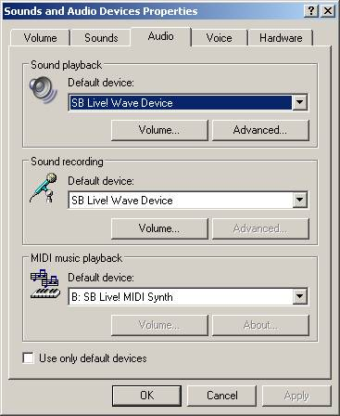
Hardware Controls
Choose which sound card to prefer when multiple cards are installed
You can have a different card for digital audio versus MIDI, for example

Slide 43
Sound Options for People with Disabilities
Narrator: Reads all text in all dialog boxes, plus text in supported applications
SoundSentry: Provides a visual cue when Windows generates a system sound
ShowSounds: Turns on captioning for any applications that support it
ToggleKeys: Plays a tone whenever Caps Lock, Num Lock, or Scroll Lock is pressed

